Slide 1
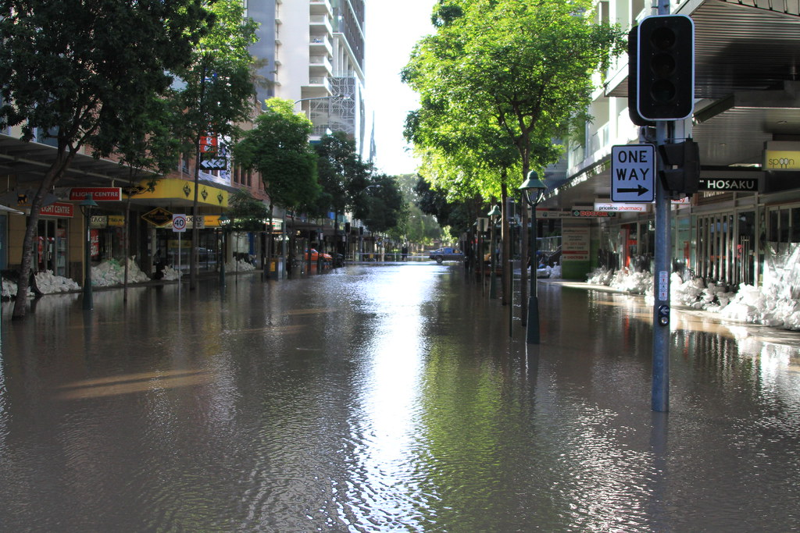
Issues due to flood
Problems caused by floods include Destruction of biodiversity, lives, livelihoods, and infrastructure.
Health hazards such as cholera due to contaminated floodwater.
Soil erosion and loss of nutrients.
Sediment deposition altering soil composition and aquatic habitats.
Habitat destruction.

Slide 2
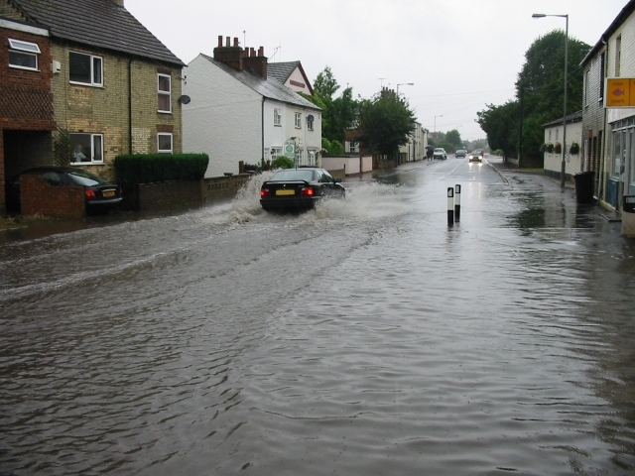
Flood risk can vary significantly depending on factors like location, topography, and climate. Here are some key points about flood risk:
Long-Term Flood Risk Assessment:
In England, you can check the long-term flood risk for a specific area using an online service provided by the government. It covers risks from rivers, the sea, surface water, reservoirs, and groundwater¹.
However, this service doesn’t provide information about the likelihood of flooding for individual properties or other sources of flood risk.
High-Risk Areas:
Areas with a 1% or higher chance of annual flooding are considered high-risk. These areas have at least a one-in-four chance of flooding during a 30-year mortgage².
Flooding doesn’t adhere to city limits or property lines
3.Global Impact:
Flooding is a significant climatic threat worldwide, affecting livelihoods and development. Climate change and rapid urbanization in flood zones further increase flood risks³.
Remember that local conditions and preventive measures play a crucial role in managing flood risk. If you’re in England, consider using the government’s online service to assess the risk in your specific area¹

Slide 3
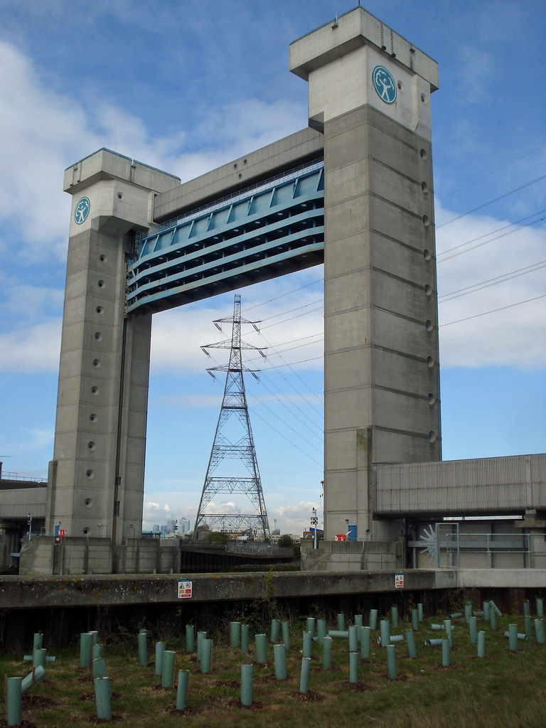
Certainly! Floods can be devastating, but there are steps you can take to protect yourself and your property. Here are some safety tips:
Before a Flood:
Avoid building in floodplains: These areas are especially prone to flooding during heavy rains. If you do live in a floodplain, consider buying flood insurance.
Construct barriers: Levees, beams, and floodwalls can help stop floodwater from entering your home. Sandbags can provide a temporary levee in an emergency.
Seal basement walls: Use waterproofing compounds to prevent
seepage.
4.Stay informed: Pay attention to weather forecasts. A flood watch means flooding is possible, while a warning means it’s occurring or will soon happen.
2.When a Flood Is Imminent:
Emergency plan: Have one in place and practice survival skills like first aid and water disinfection.
Prepare an emergency kit: Include necessary prescription medications, a small first aid kit, and charged cell phone battery.
Heed evacuation warnings: Move to higher ground if there’s a possibility of a flash flood.
Secure belongings: Bring in outdoor furniture and move important items to an upper floor.
3.During a Flood:
Avoid low spots: Ditches, basements, and underpasses become extremely dangerous during flash floods.
Don’t walk through flooded areas: It’s hard to gauge water depth and what lies underneath.

Slide 4
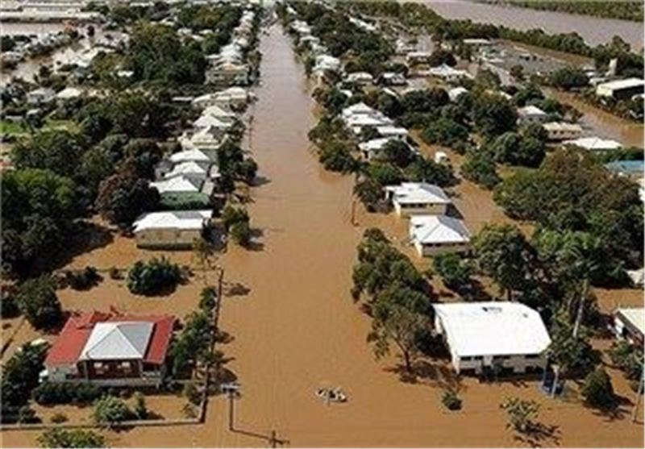
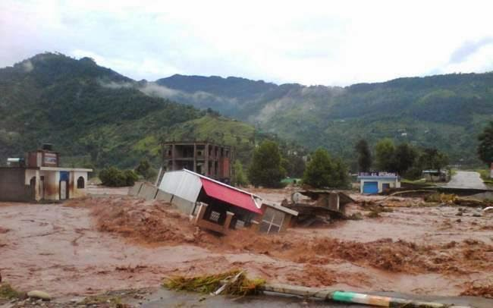
Certainly! Floods are natural disasters caused by an overflow of water onto land that is usually dry. Here are some key points about floods:
Causes:
Heavy Rainfall: Excessive rain can lead to rivers, lakes, and other water bodies overflowing their banks.
Storm Surges: Hurricanes and cyclones can cause coastal flooding due to powerful winds pushing seawater inland.
Snowmelt: Rapid melting of snow in mountainous regions can overwhelm rivers.
Dam or Levee Failures: Structural failures can release large volumes of water
2.Types of Floods:
Flash Floods: Sudden, intense floods that occur within minutes or hours of heavy rainfall.
Riverine Floods: Gradual floods caused by prolonged rain, affecting river basins.
Coastal Floods: Result from storm surges during tropical cyclones or tsunamis.
Urban Flooding: Occurs in cities due to inadequate drainage systems.
3.Impacts:
Property Damage: Floodwaters can destroy homes, infrastructure, and crops.
Loss of Life: Drowning is a significant risk during floods.

Slide 5
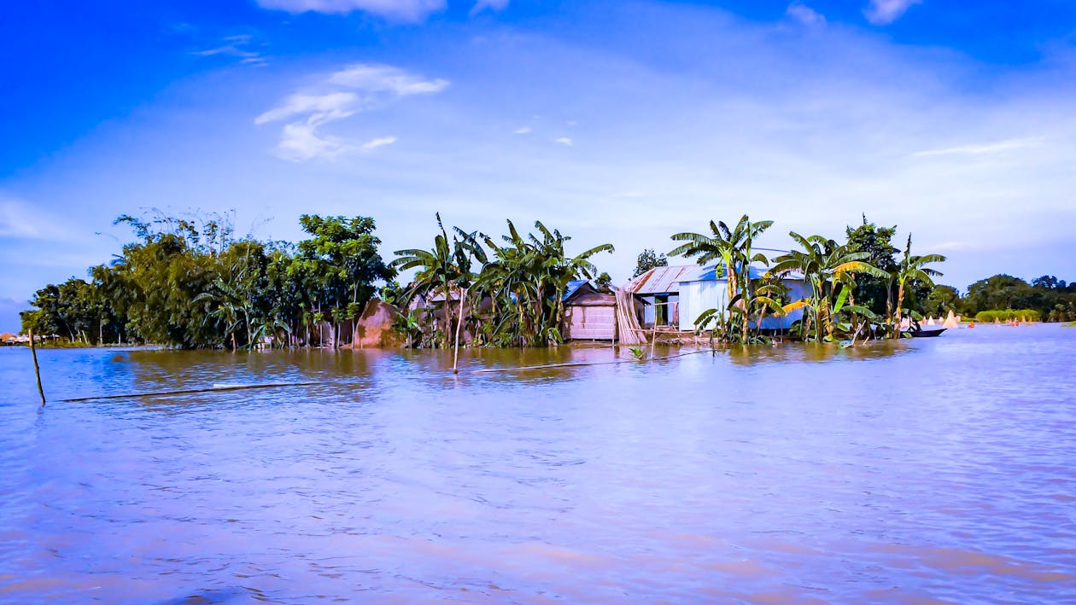
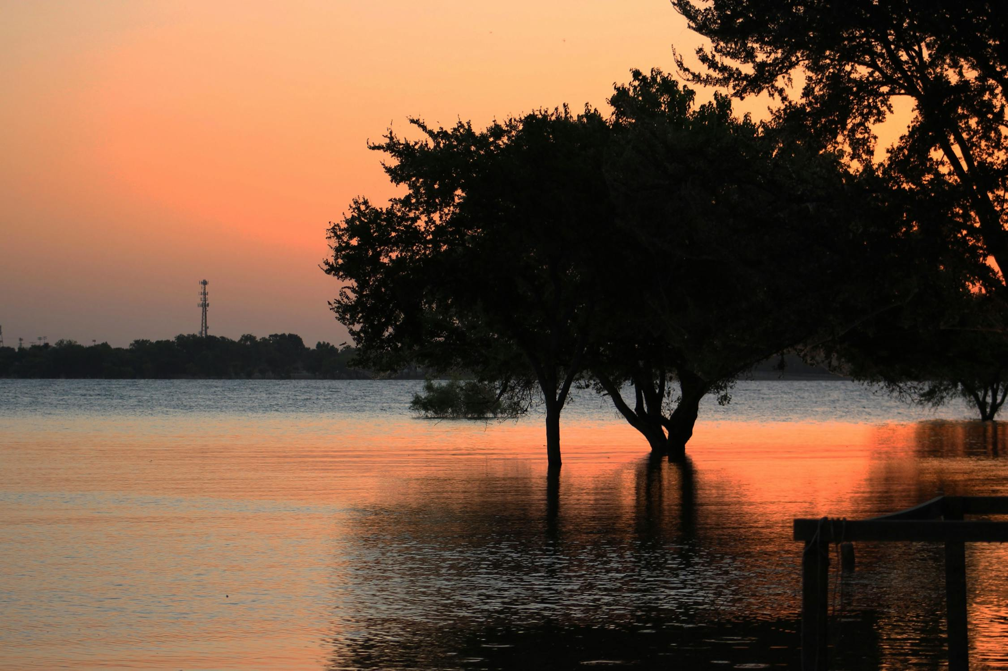
Certainly! Here are two innovative solutions that can help prevent and mitigate the impact of floods:
The Rapid Response Water-Gate:
When flooding is imminent, you need a barrier to protect yourself and your property. Traditional sandbags serve this purpose, but they require significant preparation and setup time.
An alternative solution is the Water-Gate, a rapidly deployable device made of lightweight PVC material. It utilizes the pressure of oncoming water to stabilize itself and create a dam.
The Water-Gate inflates using the water pressure, forming a makeshift dam around buildings or structures. It’s reusable and can be deployed by a single person in minutes to hours¹.
2. The Maeslant Storm Surge Barrier in the Netherlands:
The Netherlands’ Deltaworks system is a comprehensive flood protection network due to the country’s low elevation.
The Maeslant Storm Surge Barrier is part of this system. It’s one of the largest moving structures globally, completed in 1997.
Sensors detect rising water levels, triggering the walls to close and water tanks to fill along the barrier. The water weight keeps floodwaters from breaching the gates

Slide 6
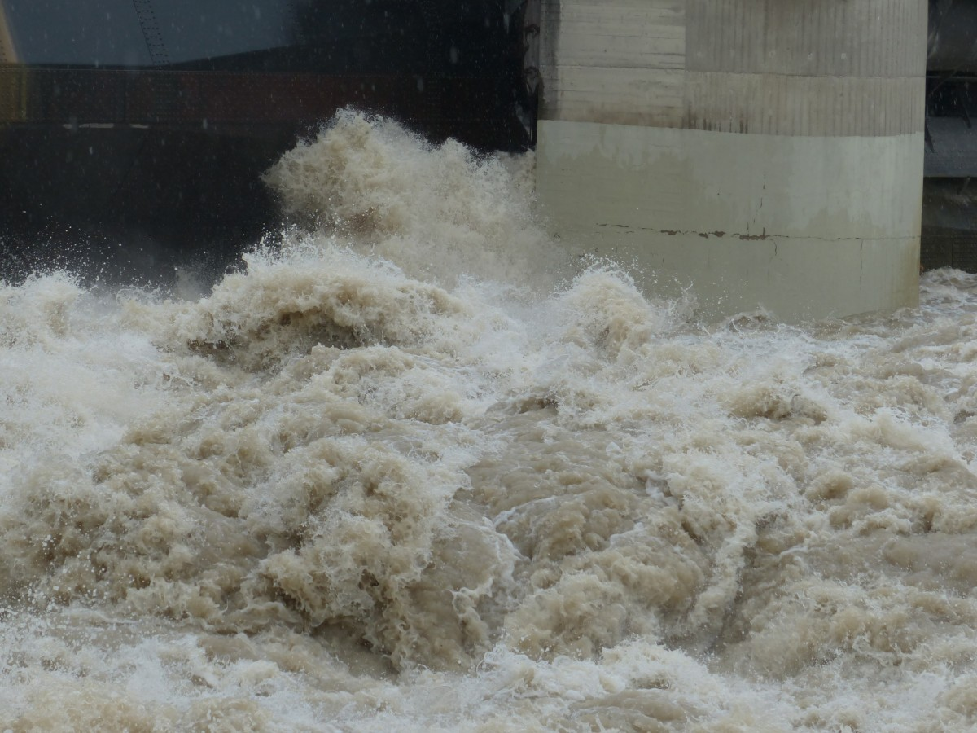
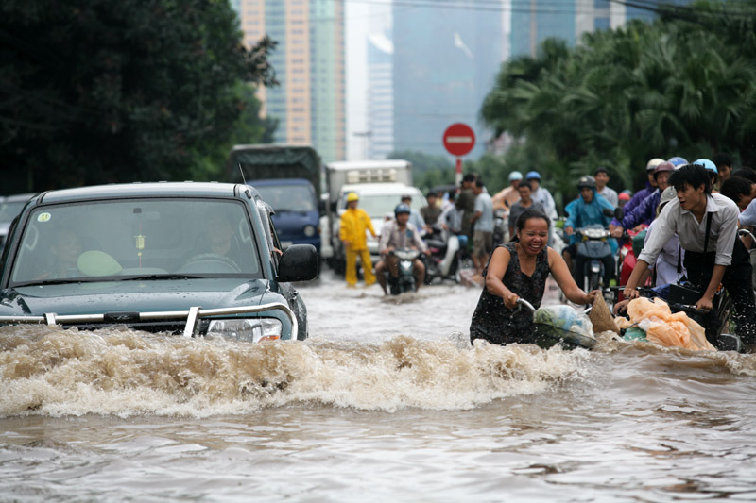
🌧️ Verse 1: Raindrop’s Lament Raindrops fall like teardrops, Invisible ink on parched earth. They gather, conspire, Whispering tales of rebirth.
🌊 Chorus: River’s Ballad (Reprise) Flow, flow, O river of time! Carry our hopes, our sorrows sublime. Through valleys and meadows, you weave, A liquid tapestry where dreams believe.
🌊 Outro: Flood’s Benediction And when the floodgates yield, Remember: chaos births creation. In the deluge, find resilience, For destiny flows in liquid revelation.
Feel free to explore the poetic currents! 🌊✨
🌑 Verse 2: Moon’s Serenade The moon, a celestial maestro, Conducts tides with silver baton. High notes of flood, low murmurs of drought, Compose a symphony of life’s marathon.

